Slide 1

Boeing Optimization Research Project
Michael Chan, Brandon To, Mike Truong
Group 45

Slide 2

Purpose
Location: Boeing Everett Factory (Everett, WA)
Goal: Optimizing arrival and departure times of salaried employees
Minimize disruption to production

Slide 3
Problems
Matching specifics on algorithm’s functionality
Giving a concrete number of workers to allocate
Unable to acquire crucial data regarding to number of parking stalls in each parking lot

Slide 4
Current Progress
Working on an algorithm that specifically recommends altering start times of salaried employees
Process has begun and meeting was on the May 15th.

Slide 5
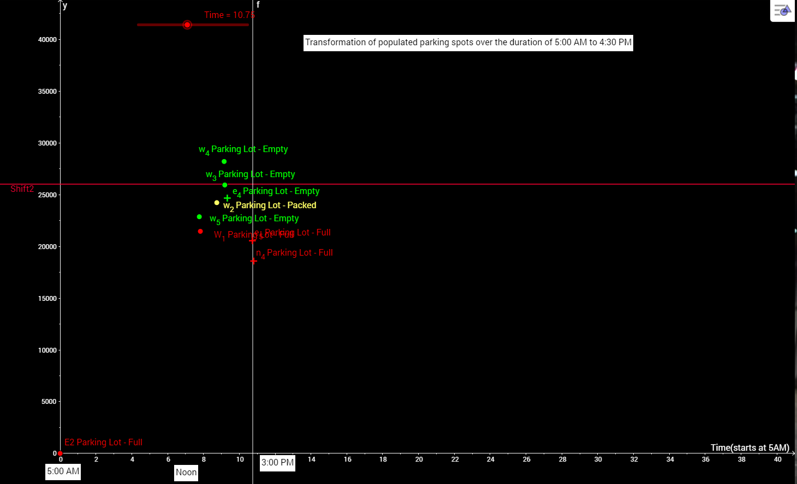
Graphical Analysis
Cause and Effect

Slide 6
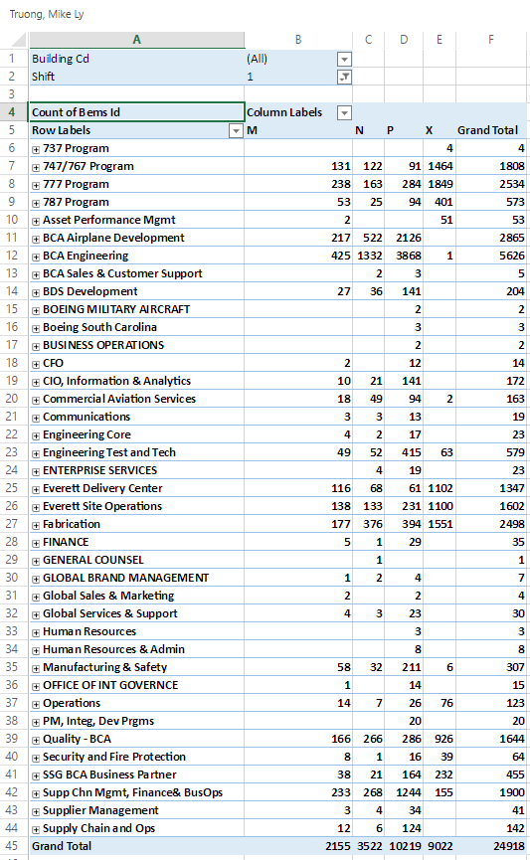
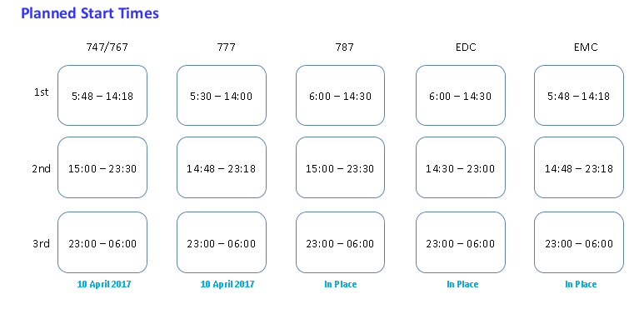
Crafting a Solution
Scatter Time
Efficiency
Workable
Realistic

Slide 7

Engineer Expo May 19th

Slide 8
Logical Analysis
We will first obtain a scope of the amount of parking stalls within each lot.
Find a correlation between non-salaried employees and the programs that they working within.
Given the maximum amount of parking stalls in a lot and the general location and population for each project, we can now proceed on to assigning them onto a lot.
Ensure that the lot can fill this given amount of people.
If the distribution of non-salaried employees fill up over 90% of one lot for example, this is not feasible.

Slide 9
Logical Analysis (Cont.)
Subtract the maximum occupancy of the lot by the number of estimated non-salaried workers are stationed to park within that lot.
Refer to the spreadsheet of the amount of salaried workers and determine program associated with location.
Allocate to the given lots closest to their location.
If the given amount of workers for one lot exceeds the occupancy, determine the sum of the overall salaried employees that have exceed the given space.
Determine percentage of salaried workers that should be recommended to be moved to second shift.

Slide 10

Linear Program
I wanted to find a way to solve the issue using CS
Mathematical model which takes variables and a set of constraints and finds an optimal solution

Slide 11
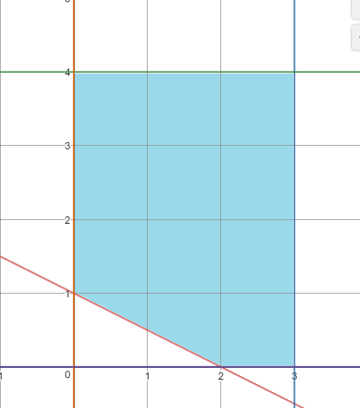
Short rundown of LP
Maximize x+y
Subject to:
X+2y >=2
X <= 3
Y <= 4
X >= 0
Y >= 0

Slide 12
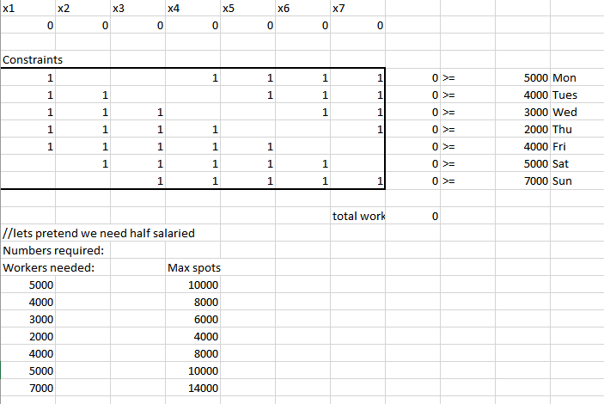
Day scheduler
Notes:
This is a method using linear programming to final an optimal solution for finding the number of employees to have come in at specific days based on their work schedules. The Constraints cells shows the potential work schedules that a set of employees may have. This is an example matrix that shows 7 different work schedules where employees choose to work 5 days in a row with 2 off, with this happening on each possible day of the week. There can potentially be more or less schedules to adapt to the flexibility of salaried work weeks.
The x1,x2,.. variables are the number of workers who start on the day they represent. X1 is Monday, x2 Tuesday, Sunday is the last day at x7. The numbers to the right of the >= signs are constraints on the numbers required. There is no way to know exactly how many people are needed for daily duties to be accomplished, so this is just a theoretical number. The number to the left of the >= sign is the number of workers for each day that are working. Total workers is the number of starting workers each day summed.
Constraints:
All values must be integers;
Workers within each day must be greater than the required amount;
Workers can’t be above the max spots

Slide 13
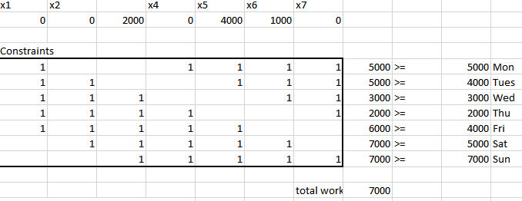
Optimal solution
Notes:
We can create even more complex programs with more realistic constraints and schedules. The schedule can also be even more detailed, allowing us to optimize within each day by hour as well. There are also constraints that need some more looking at, such as potential max spots. In reality, it would be total spots minus hourly workers, and salaried workers would fill the remaining.

Slide 14
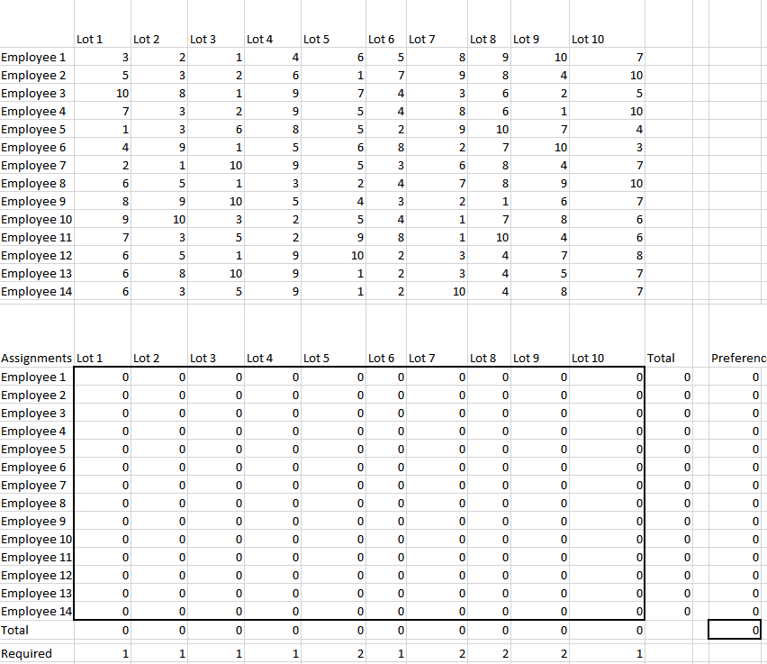
Employee Parking
Notes:
The top table represents 14 employees with lot preferences ranging from 1-10, with 1 being most preferred. The second table contains the changing variables that indicate where each employee will park. The total row will equal the total workers that park within each lot. The total column is total lots each worker parked in. The goal is to “minimize” each preference so each worker gets the highest happiness while meeting the constraints on where each worker “must” park. The required row indicates this by saying the minimum amount of workers parking at each lot. The black bordered box in the bottom right is the objective that gets minimized.
Constraints:
There can only be one lot an employee parks in;
Each cell can only be binary, ensures that total is 1;
The total in each lot must equal the required;

Slide 15
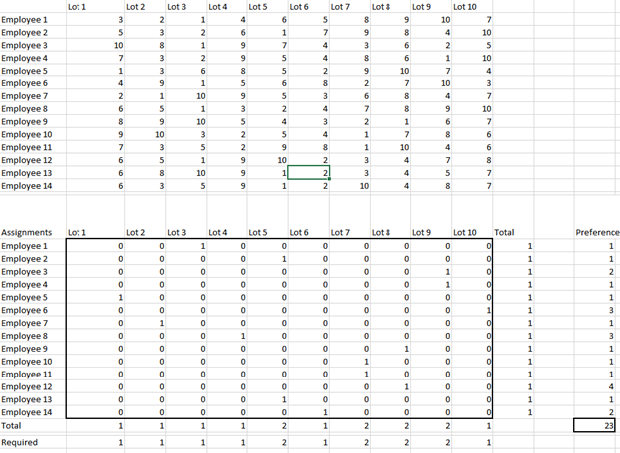
Employee Parking

